Slide 1
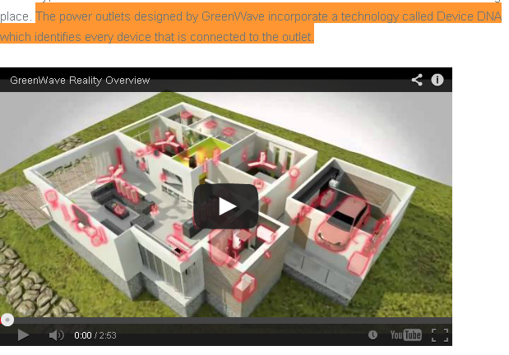
GreenWave Reality Solutions
**Concept video Dated April 2011

Slide 2
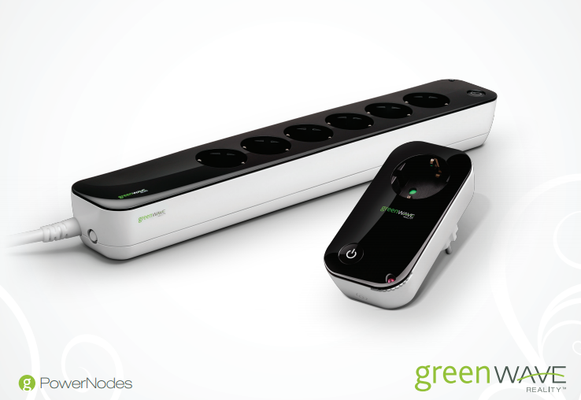
Competitor Product

Slide 3
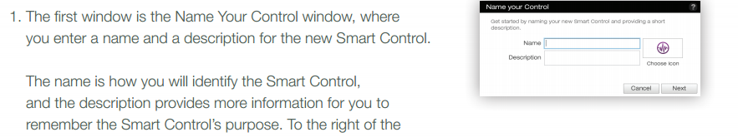
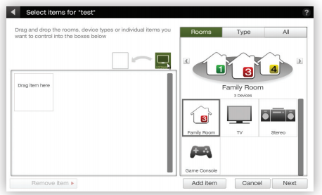

Slide 4
GreenWave Selling Points
-Room Colors
Manual dials for assigning devices to a room
-Scheduling
-Energy Consumption
-LED Bulbs w/ NXP chip to drive intensity, relay
-Home Monitoring
-No Mention of “Device DNA”

Slide 5
Whats Next
Proceed with waveform recognition add on to ems
no clear competitor with this technology
Arrival of PO?
Begin ASAP to meet deadlines

Slide 6
Links
http://walyou.com/greenwave-energy-monitor/
http://greenwavereality.com/downloads/pdfs/PowerNode_manual_english.pdf
http://greenwavereality.com/downloads/pdfs/energy_portal_guide.pdf
http://greenwavereality.com/downloads/pdfs/KitInstallationGuideEnglish.pdf
http://greenwavereality.com/downloads/pdfs/gateway_manual_english.pdf

